Slide 1
Ideafest 2022
Artificial intelligence and diabetic retinopathy

Slide 2
Issue : diabetic retinopathy
4.1 Million Americans > 40
Jama
900,000- “vision Threatening DR’
JAMA
Native Americans 2x more likely than non-Hispanic whites
NIH
South Dakota is home to 80,000+ Native Americans
US Census Bureau 2020

Slide 3
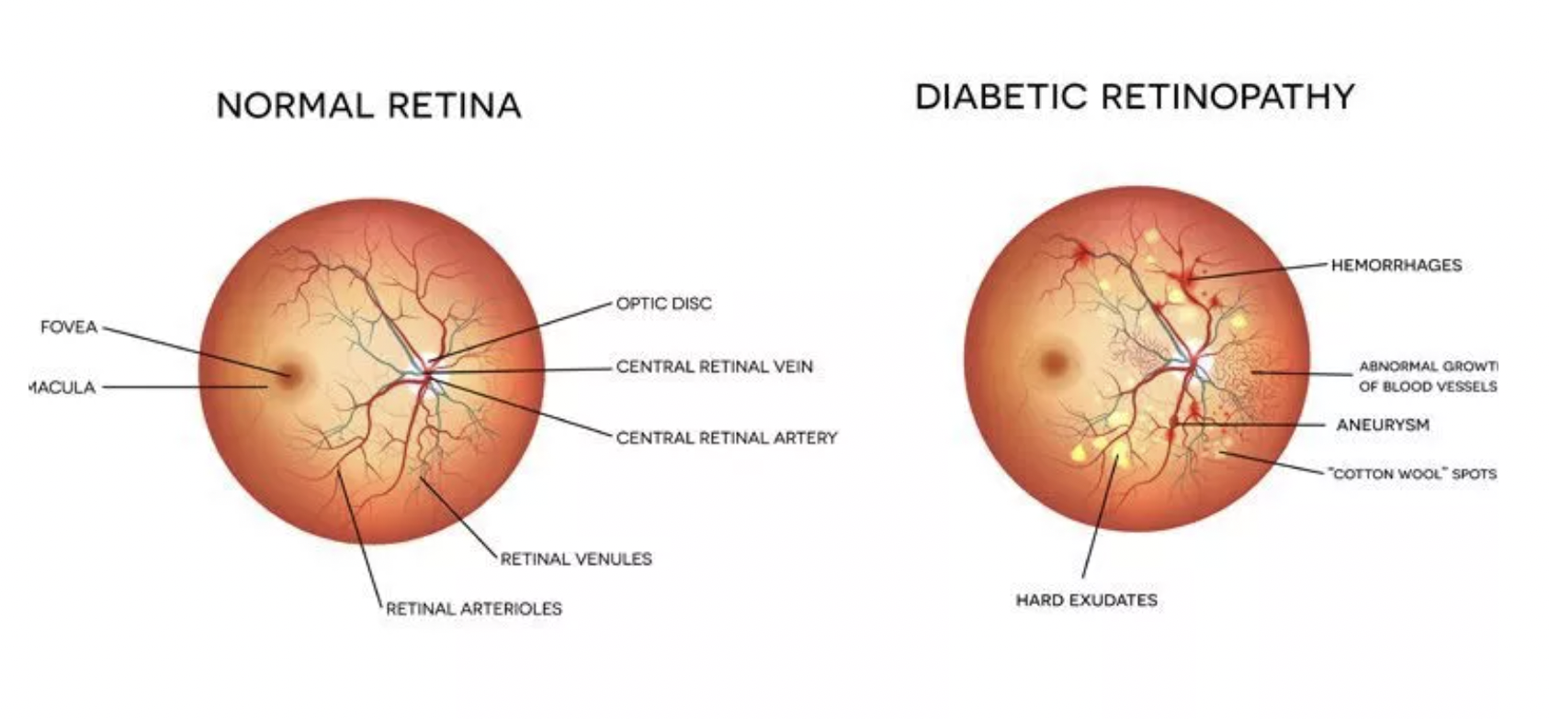
Diabetic retinopathy visualized

Slide 4
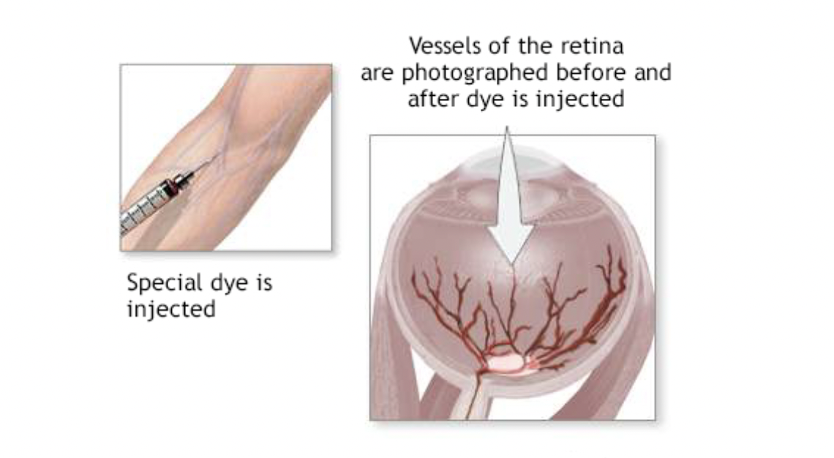
Methodologies- FA
fluorescein angiography
Invasive & time consuming
Uses fluorescein coloring
Allergic reactions

Slide 5
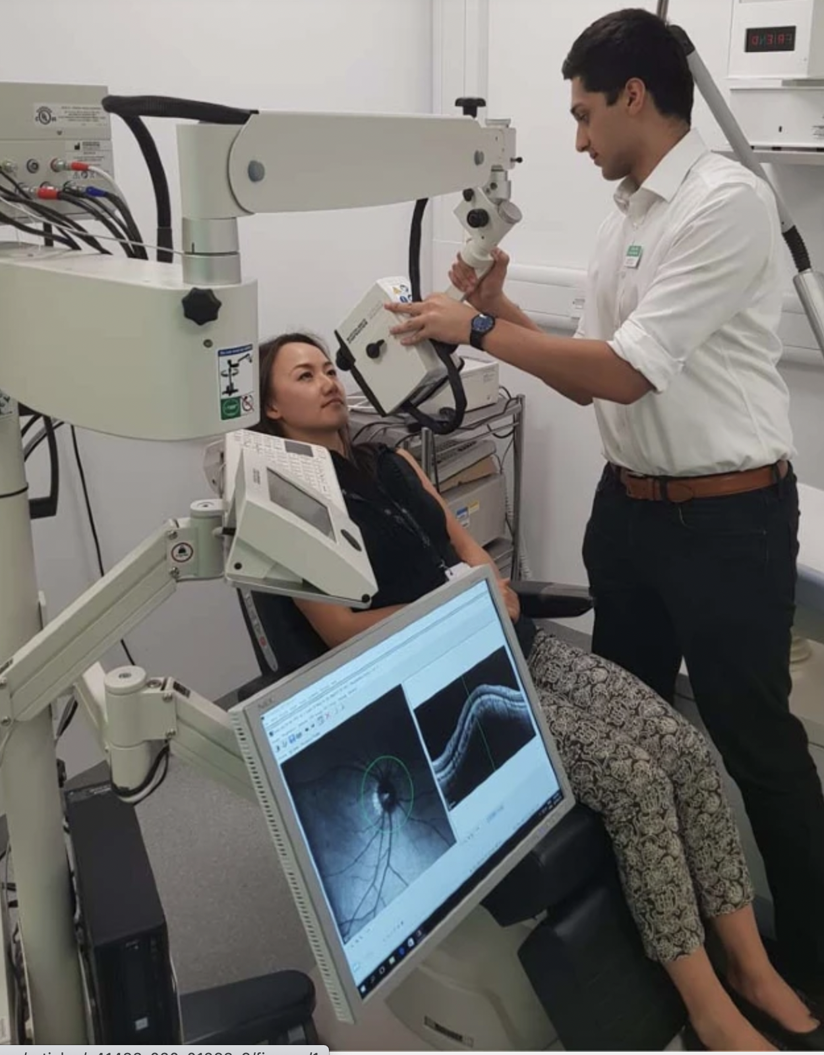
methodologies- OCT
Optical coherence tomography
Costly- machine $100k
images $600-$39k images

Slide 6
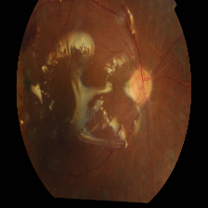
Fundus imagery data set
No DR
-1806
Mild
-371
Moderate
-1000
Severe
-194
Prolific
-300

Slide 7
AI models
CNN-Convolutional neural networks
Inception v3
VGG19-Visual geometry group 19

Slide 8
execution
50 epochs
Batch size 32
Steps per epoch 90
Validation steps 20

Slide 9
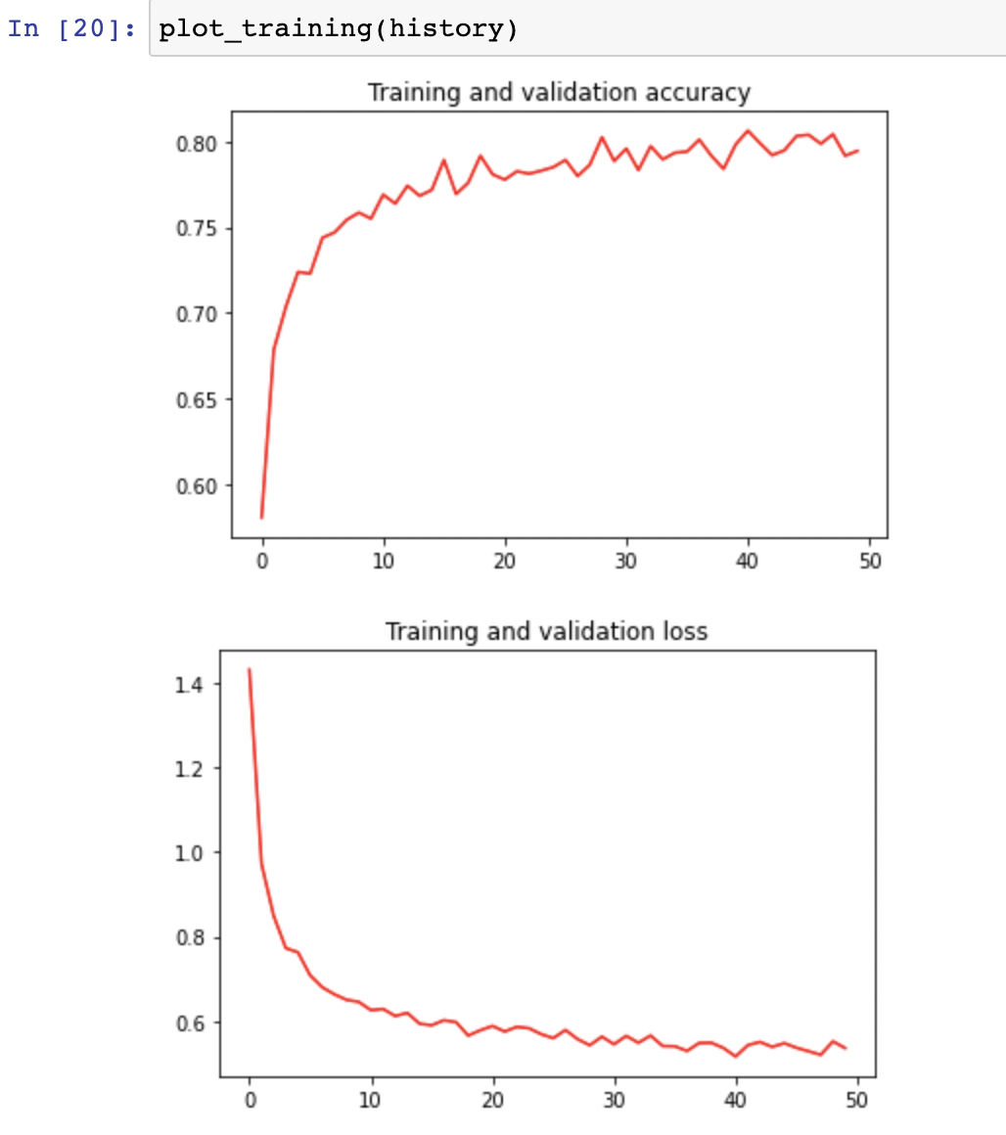
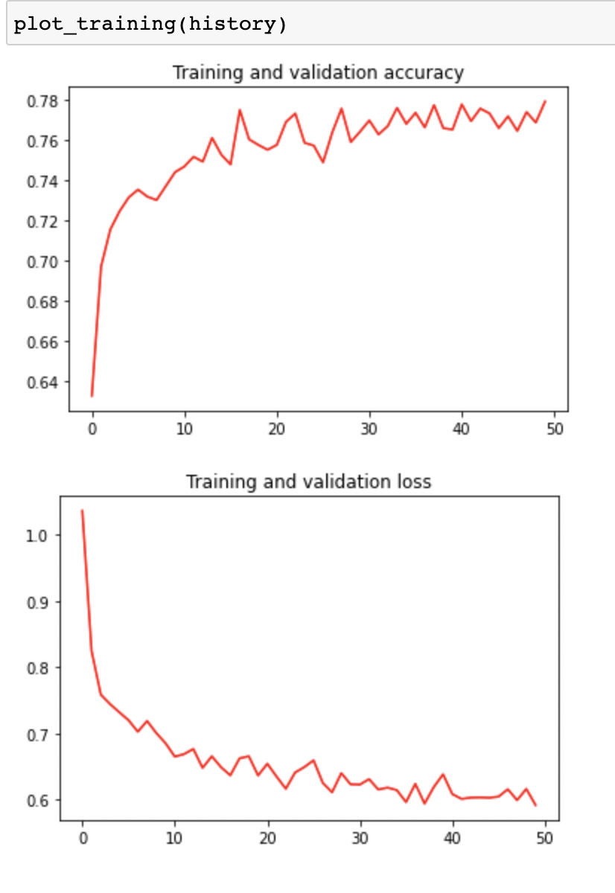
graphs
VGG19
Inception V3

Slide 10
Results
Inception V3
Accuracy- 77.9%
Precision score- 74.6%
VGG19
Accuracy-79.4%
Precision score- 74.8%

Slide 11
Real world applications
Remote deployments
Smartphone portability
Diabetic retinopathy & cardiovascular diseases…

Slide 12


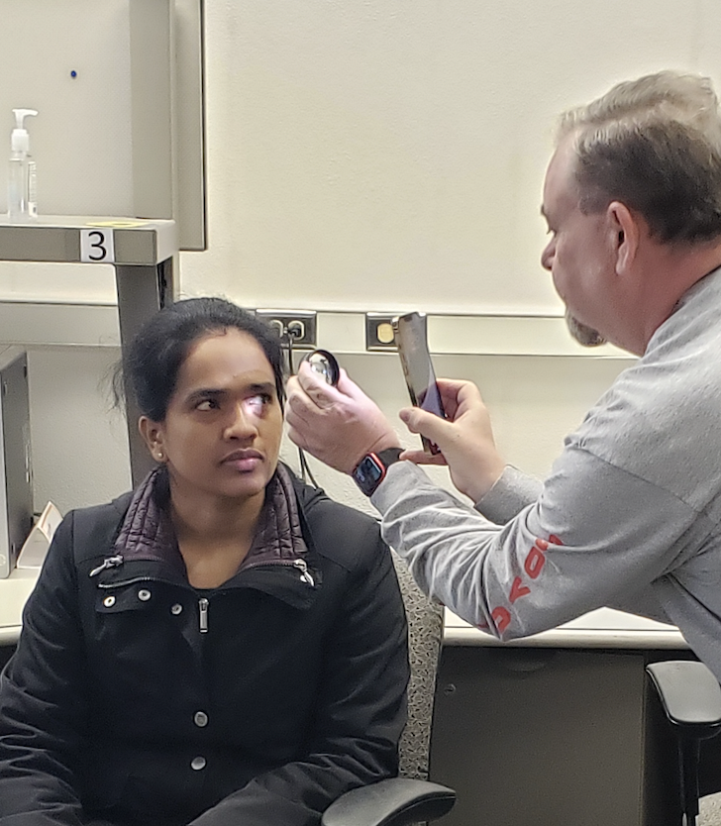
Future work
Field researchers
20D double aspheric lens
Mydriatic drops
Minimal training
Smartphone TEHI* app
Binary CVD screening

Slide 13
Questions?

